Slide 1
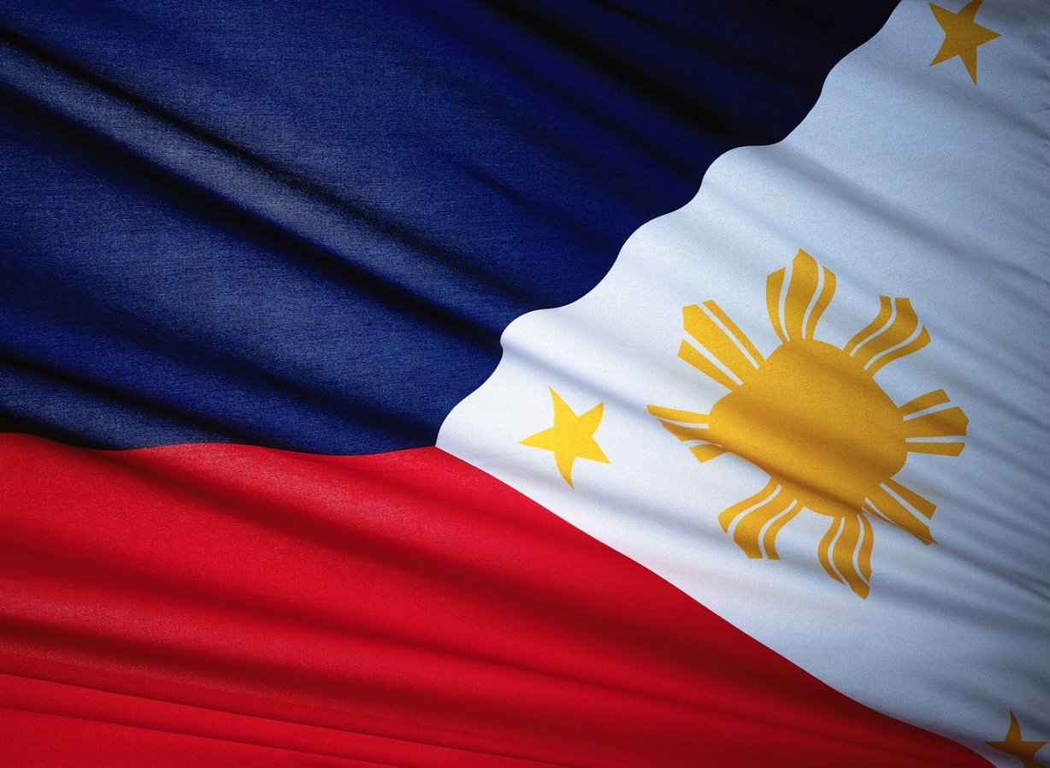
Welcome To The
Philippines!!!
Come on and visit us.
Three of our most popular cities:
Manila
Cebu
Laguna
Kamusta (Hello) !

Slide 2
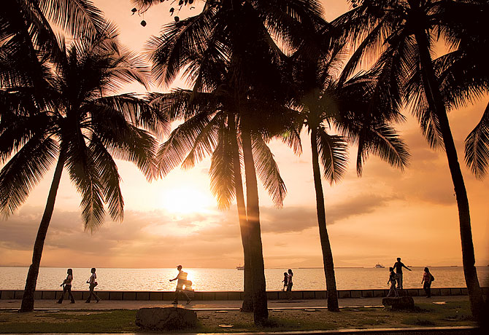
First Stop Manila!
http://travelhouseuk.files.wordpress.com/2009/11/manila.jpg

Slide 3
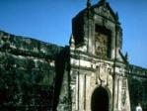
Intramuros
Located on the southern bank of the Pasig river, is the medieval Spanish walled enclave of Intramuros. This area is filled with historic buildings and churches. A great place to see how religious practices were done in the past and to learn great history of how the Filipino culture was established.
http://www.unitedtravel.wordtravels.com/Cities/Philippines/Manila/Attractions

Slide 4
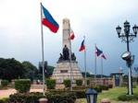
Rizal Park
Named after the famous Filipino anti-colonist, philosopher and writer, Dr. Jose Rizal. The park is around 58 hectare equivalent to 143 acres. This is one of the largest parks in South East Asia consisting of many ornamental gardens, a chess plaza, and even a skating rink. There is also an open air auditorium where if you are lucky you can see a free concert. This park can be a whole day adventure, with all the recreational activities and its lush green grass where walking around in the fresh air is ideal. If another history lesson is what you desire, there are a couple of museums located in the park.
http://www.unitedtravel.wordtravels.com/Cities/Philippines/Manila/Attractions

Slide 5
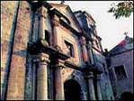
San Agustin Church
Located in the enclave of Intramuros is one of Manila’s oldest stone churches, San Agustin. Construction finished around 1606 and has withstood time and is still standing strong today. Through the carved door, you may see a Baroque pulpit, and an 18th century pipe organ. In this monastery there is a museum as well as a church. On the walls of this stone church hangs many religious paintings. Within the Intramuros enclave this Church stands to be one of the most popular attractions.
http://www.unitedtravel.wordtravels.com/Cities/Philippines/Manila/Attractions

Slide 6
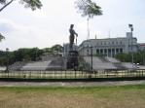
National Museum of the Philippines
If you didn’t get your fill of the first few museums from the previous attractions, this museum shows history of the whole country, with in depth exhibits. While your in Rizal park come by and take a look in the National Museum. This is the attraction where you will find most of the tourists. This is a comprehensive showcase of the cultural, historical, and natural heritage of the islands of the Philippines.
http://www.unitedtravel.wordtravels.com/Cities/Philippines/Manila/Attractions

Slide 7
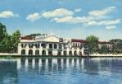
Malacanang which comes from ‘May Lakan Diyan’ which means there lives a noble man. Located on the same river as the Intramuros, Pasig River, since the 18th century when it was built for a Spanish Aristocrat. Through time it became the palace of the head of state, now it is a museum where one can see mementos from the long line of Philippine’s presidents. Even the mementos of Ferdinand and Imelda Marcos, who set the Philippines under a dictatorship in the 1970’s are located there. This is a great place to visit to learn what kind of leaders led this country and if you have not caught on Spanish culture is a big part of the Philippines.
Malacanang Palace
http://www.unitedtravel.wordtravels.com/Cities/Philippines/Manila/Attractions

Slide 8

American Cemetrery and Memorial
This is a tranquil arena in contrast to the hustle and bustle of the city of Manila. The cemetery near the Makati commercial centre, is heavily visited by tourists. This cemetery holds a lot of fallen soldiers from WWII, a high influx of veterans can be seen here. Along with the small chapel located here, there are engraved marble columns which has the names of soldiers missing in action. A nice quiet place, and a way to pay respect to many who sacrificed their lives for a country they were not even born in.
http://www.unitedtravel.wordtravels.com/Cities/Philippines/Manila/Attractions

Slide 9
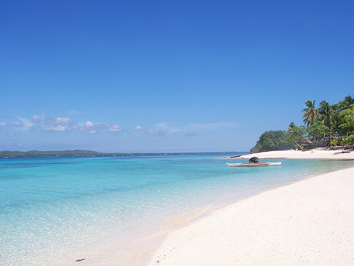
Second Stop Cebu!
http://farm1.static.flickr.com/55/111877806_6837b6e337.jpg

Slide 10
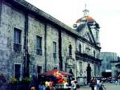
Basilica Minore de Santo Nino
This is one of the oldest religious relics in the Philippines. Where an icon of the infant Jesus is found in the Basilica Minore. This icon has survived through fires and catastrophes since Magellan presented the image of Christ to Queen Juan in 1521. The building itself was built in 1565 then rebuilt after a fire in 1602. This is a great first visit, to see one of the first interpretations of Christ that the Spanish had, which is still intact in the church.
http://www.wordtravels.com/Cities/Philippines/Cebu/Attractions

Slide 11
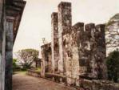
Fort San Pedro
Located in the wharf area of the city of Cebu, is Fort San Pedro which was the nucleus of the first Spanish settlement in the Philippines. Now the fort gives an idea of how Cebu was in the past, as well it has been transformed into a museum/park. This fort was a bastion built in 1565 and was not completed until 200 yrs later. Over time this fort has served many different purposes: watch tower in the 1700’s, prison for revels, barracks for the U.S. Army, and a prison camp during WWII. The theme of Spanish and U.S. involvement is very heavy not only in Manila and Cebu but the Philippines. That is why this is a spot a would not miss.
http://www.wordtravels.com/Cities/Philippines/Cebu/Attractions

Slide 12
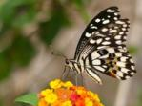
In the district of Basak, Jumalon Museum can be found. Which was created by a lepidopterist, the late Professor Julian Jumalon. Which encloses unusual collection of mosaics, which is made of butterfly wings. Jumalon’s home which has a garden is still a haven for thousands of butterflies, and the lepido mosaics are in the salon. This museum shows the beauty of nature that is in the Philippines. If the miraculous grace and beauty of butterflies is your thing, this is a place you can not miss out on.
Jumalon Museum
http://www.wordtravels.com/Cities/Philippines/Cebu/Attractions

Slide 13
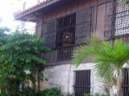
Casa Gorordo was the home of the first Filipino Bishop of Cebu. Since his death his home has been restored and recreated to look like a typical Filipino home of the late 19th century. It is filled with religious relics, paintings, furniture of that time. The Casa Gorordo showcases some contemporary art exhibits. This location is a great place to go see how houses were in the past and it opens a window in how people of that time lived and functioned.
Casa Gorordo Museum
http://www.wordtravels.com/Cities/Philippines/Cebu/Attractions

Slide 14
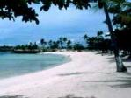
Beaches
One of the main reasons Cebu is visited is, for the amazing beaches located there. A bridge connected near the metropolitan area of Cebu, is Mactan Island. This island host over 100 different beach resorts. Then there is also Olango island that has the pristine white sand, while south of it is Kansatik which is a ideal location for scuba diving with the beautiful coral and colorful fish. Cebu city is fine and dandy, but once you get out of the city is when the fun begins! You can spend months visiting every beach and not getting tired of it at all. This is one of the top sought after attractions for beaches.
http://www.wordtravels.com/Cities/Philippines/Cebu/Attractions

Slide 15
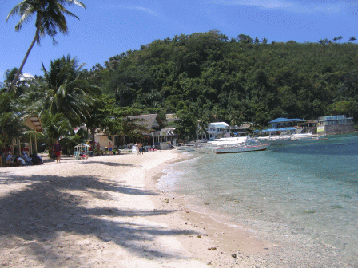
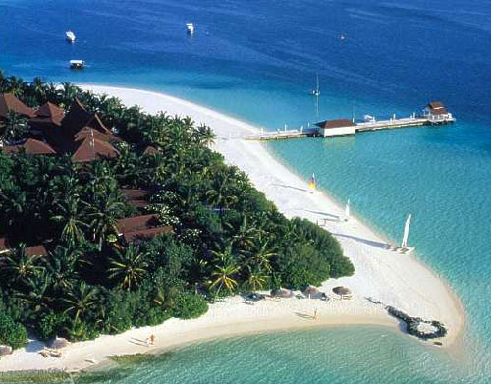
Do you want more beaches?
Come to Laguna!
http://www.philippines-travel-guide.com/images/bllb-palm-beach-view.gif
http://www.santour.ru/Maldivs/images/hotels/lagunabeachresort/laguna_beach_resort_2.jpg

Slide 16
Puerto Galera
Is the Island in Laguna that has the most renowned beaches in the world
Beaches consist of:
  Sabang Beach
    Known for the night life
  Big La Laguna Beach
    White sand and crystal clear water
  Many more but not as popular
    Night life non-existent and water not up to Big La Laguna’s standards, but perfect water for surfing. Tons of beach houses are located on the shores of Puerto Galera.

Slide 17

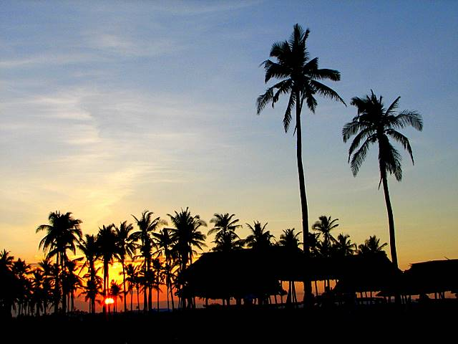
Please Come Visit Soon!
Whether you come for:
Recreation
Entertainment
History
Relaxation
Beaches, fun or more
We will not disappoint.
http://ghie0003.files.wordpress.com/2008/10/paradise-philippines.jpg

